Slide 1

Why Vantagepoint?
Key Tenets and Value Drivers
Bret Tushaus
VP, Product Management
Notes:
Hello and welcome to the Key Tenants and Value Drivers edition of our Why VantagePoint video series. My name is Bret Tushaus and I lead up a number of the product management teams here at Deltek including the Vantagepoint team. This video series is targeted at demonstrating to vision using organizations the many compelling reasons to execute their upgrade to the next version of vision, that is Vantagepoint.
Other videos in this series will focus on key features and functionality within different parts of the product and serving specific personas within your firms. In this video, I'll provide a high-level overview of the key things organizations should be aware of in regard to the many benefits of upgrading to Vantage Point. With that, let's jump in.

Slide 2
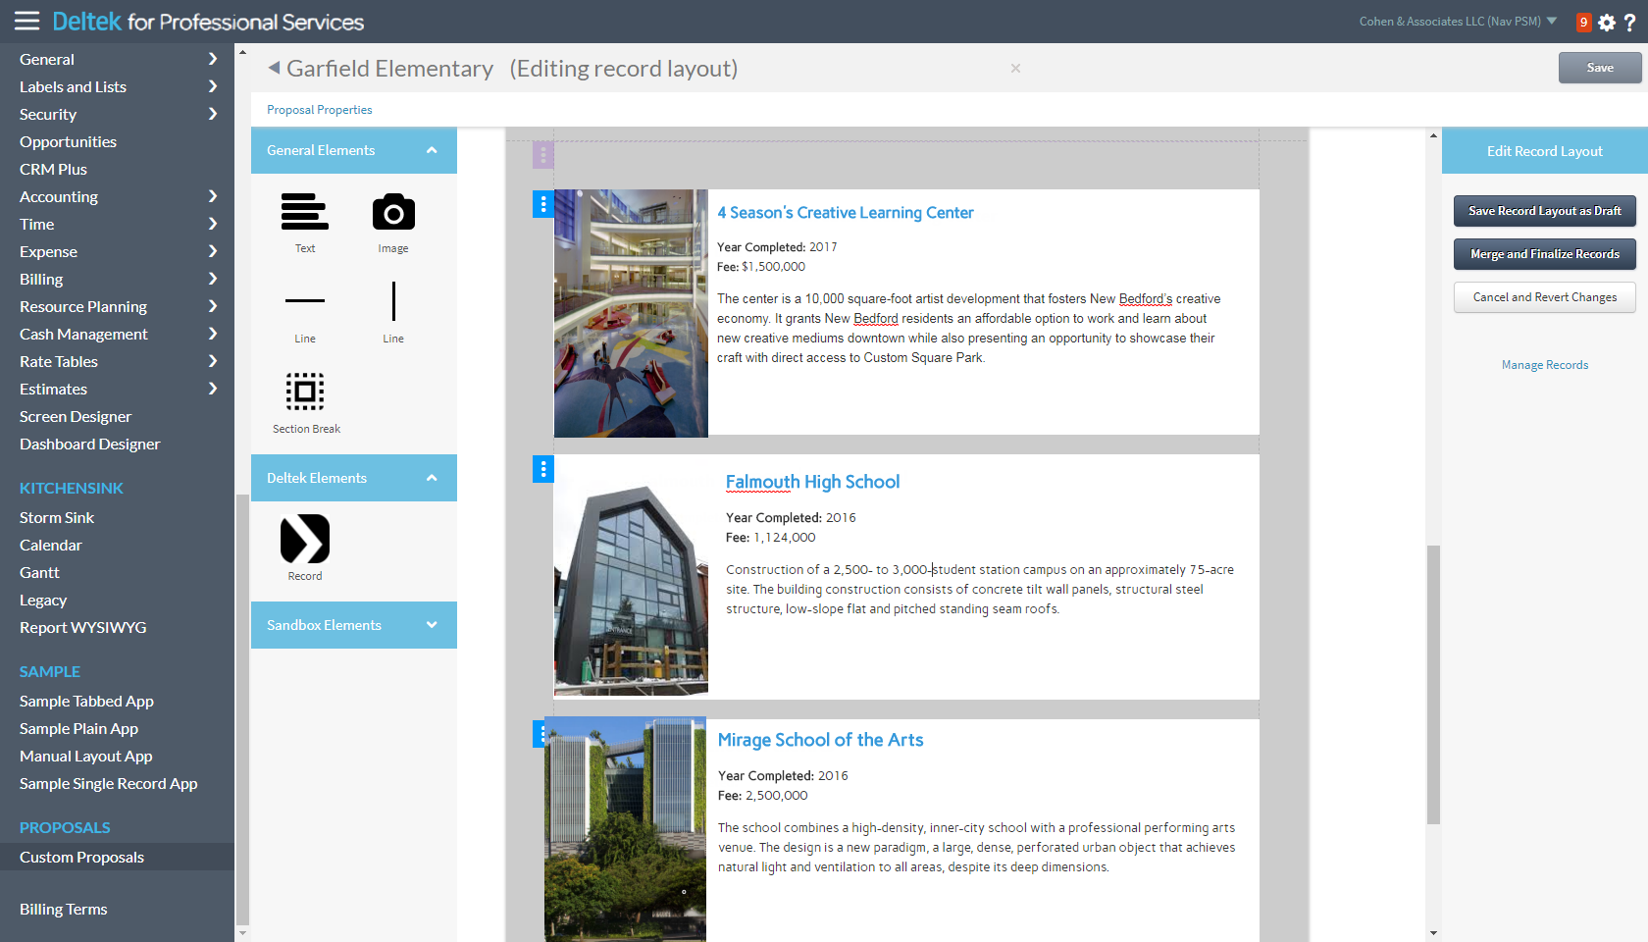
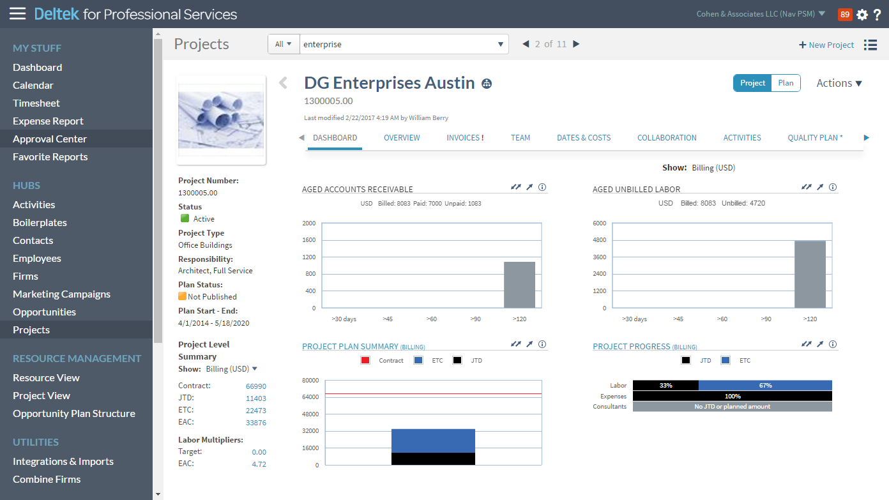
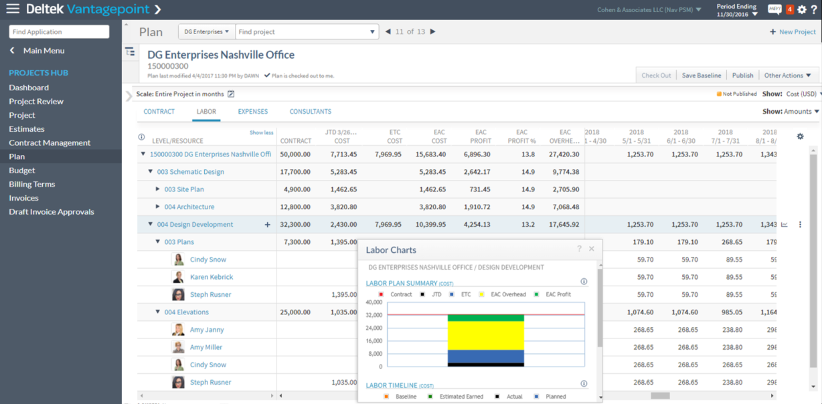
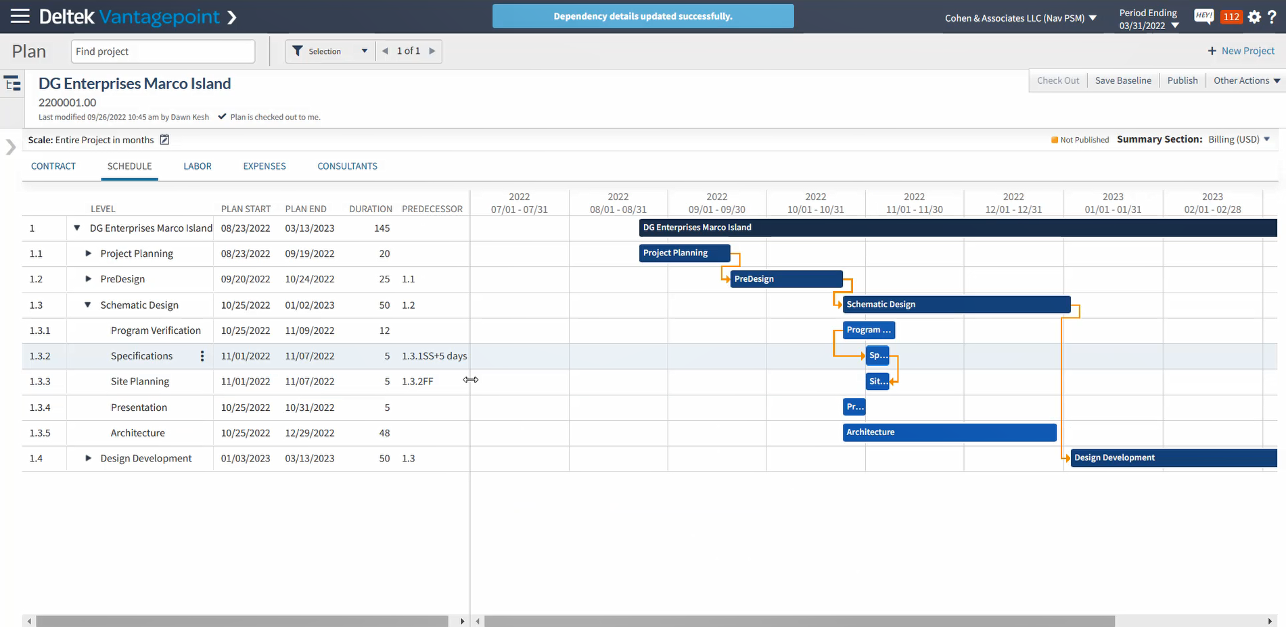
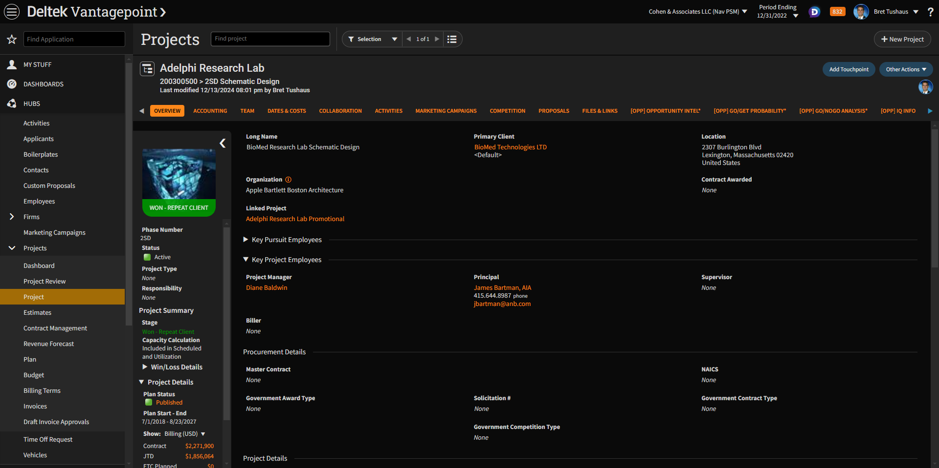
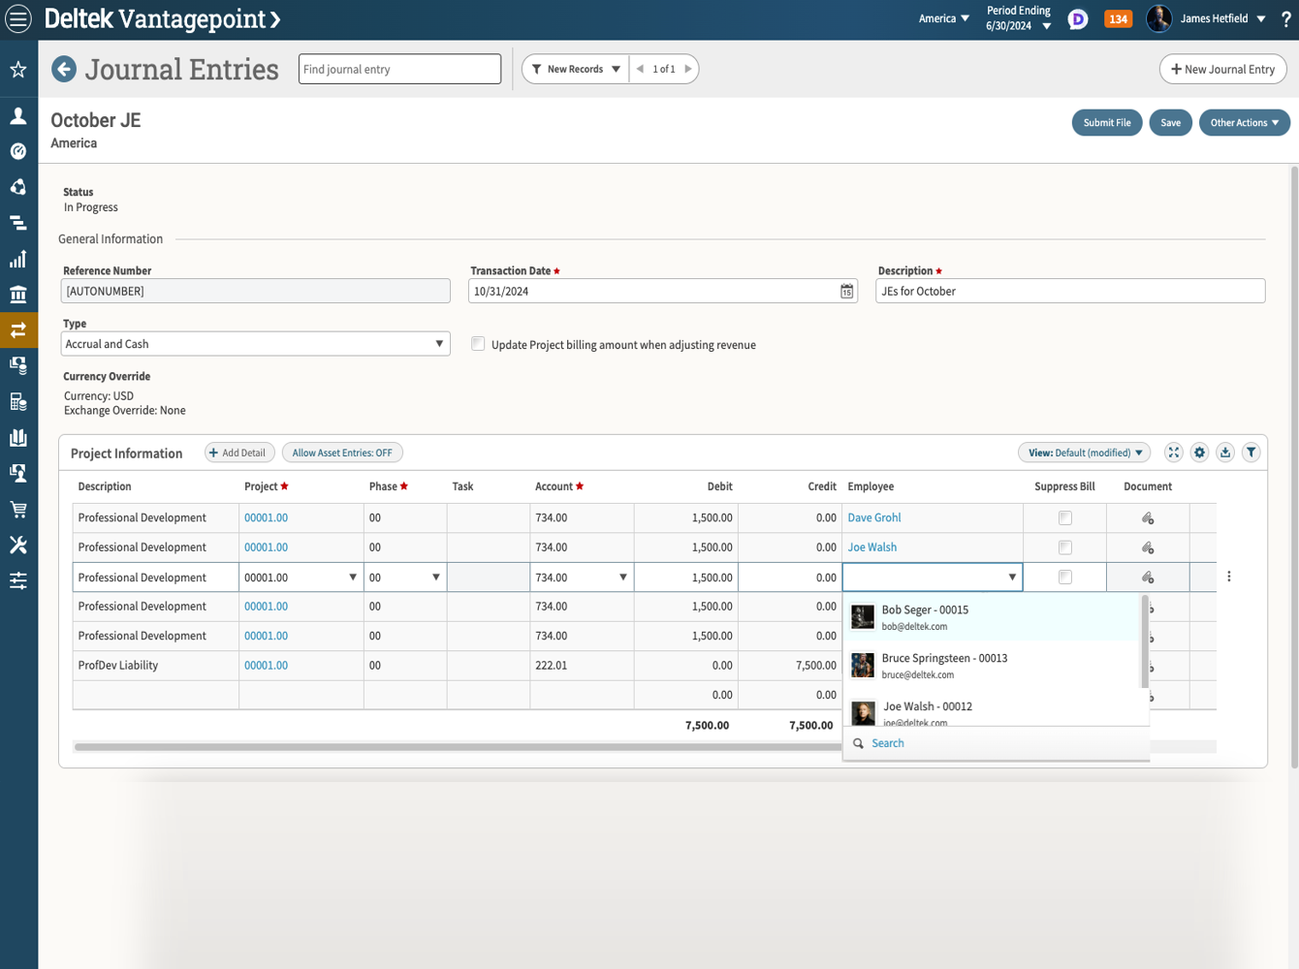
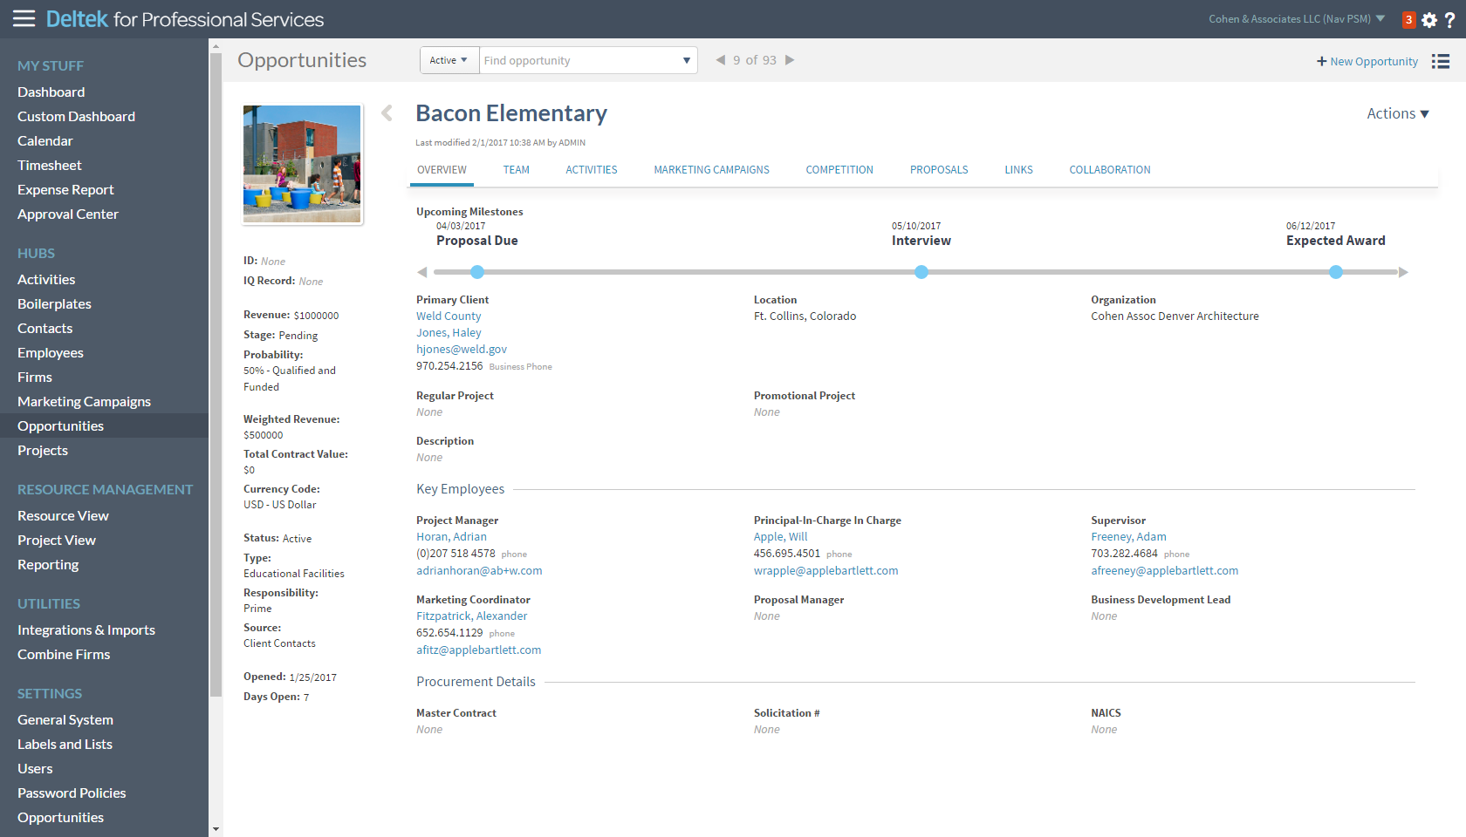
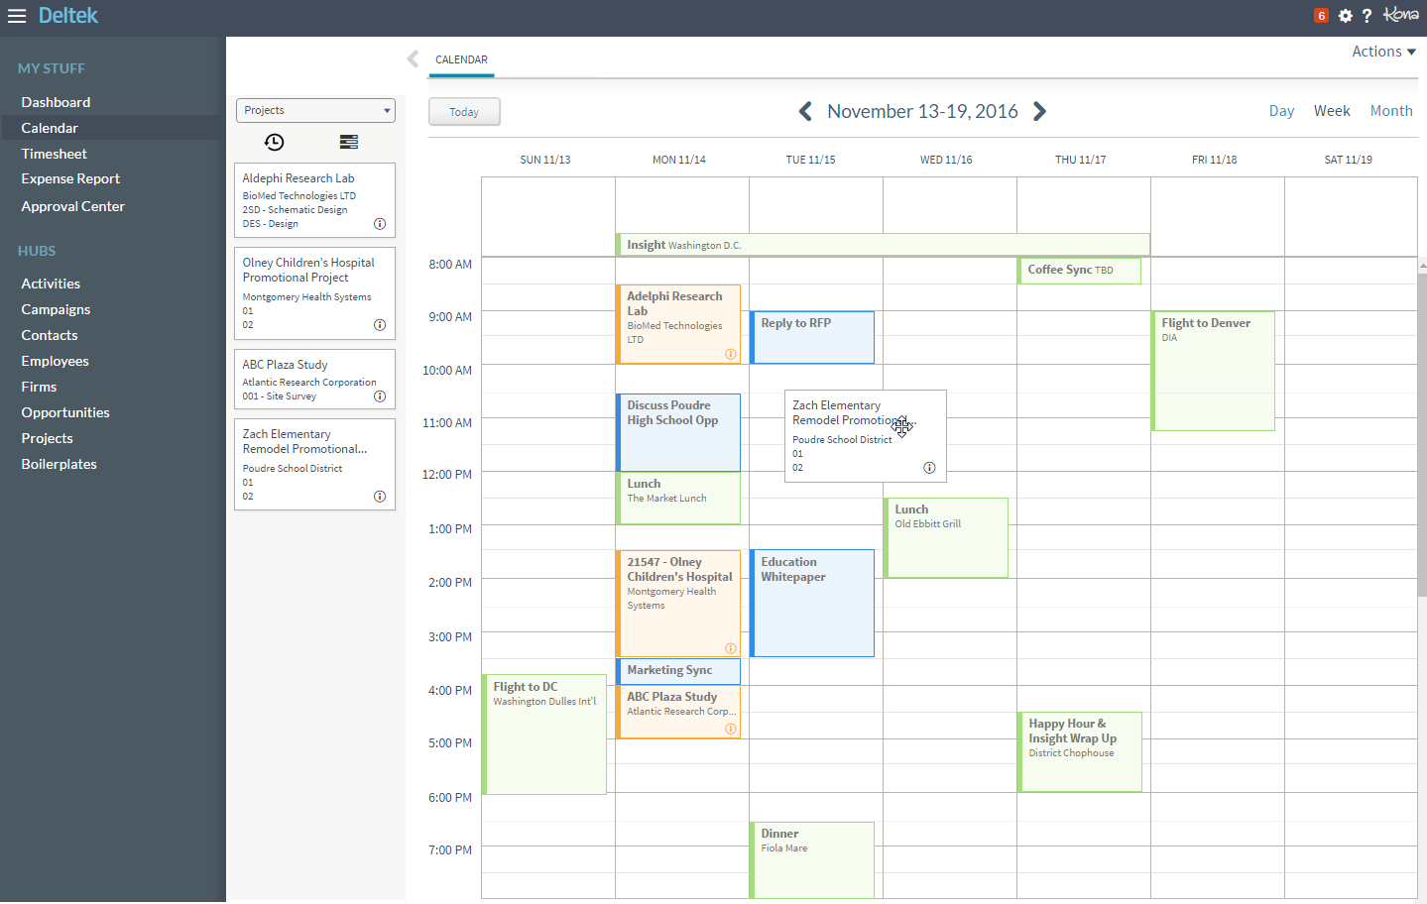
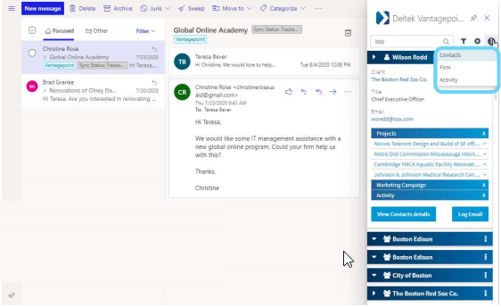
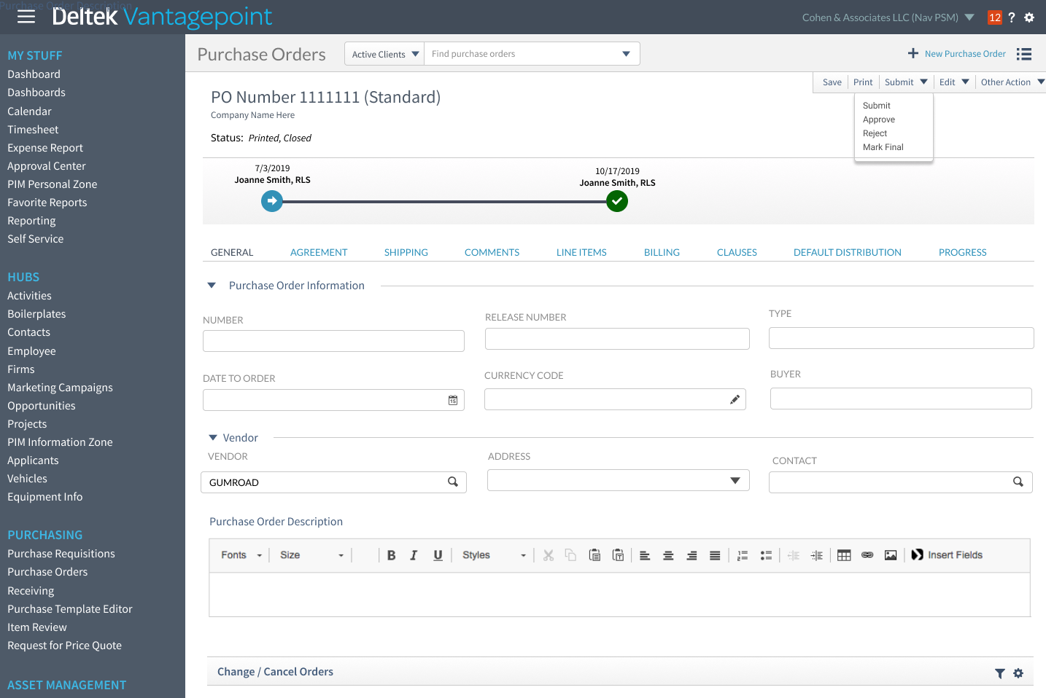
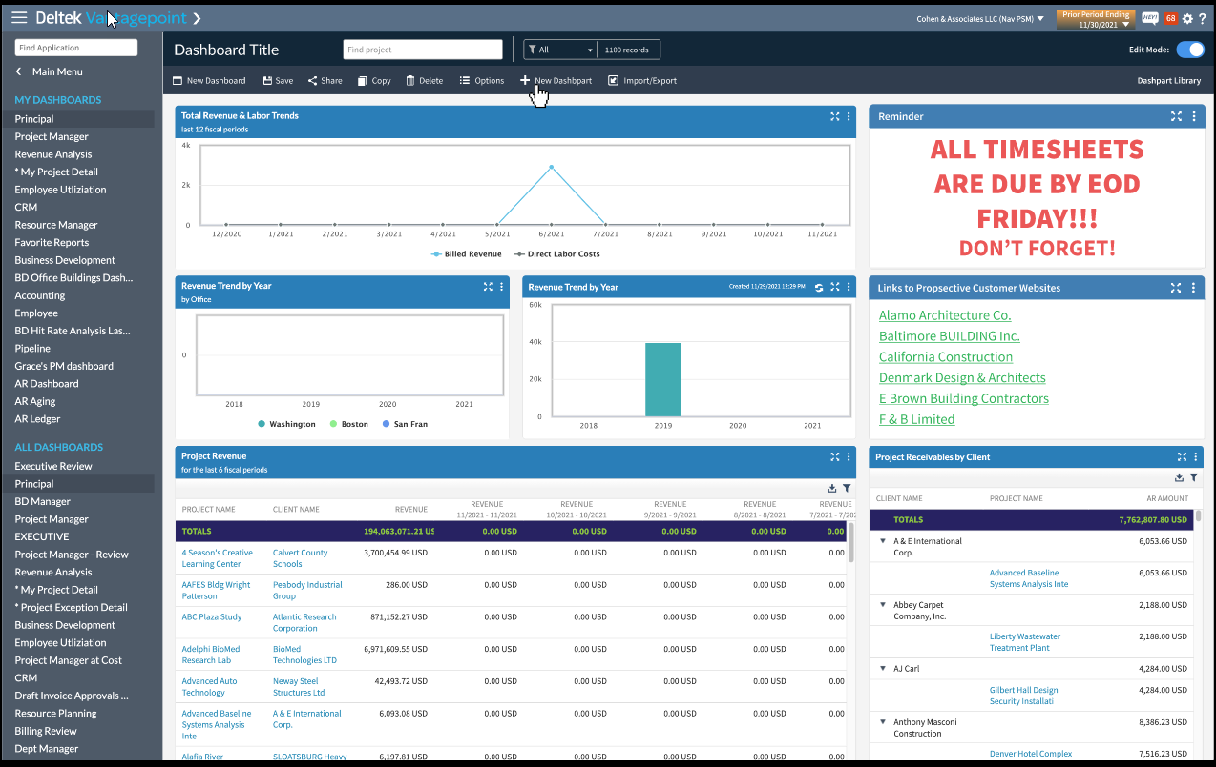
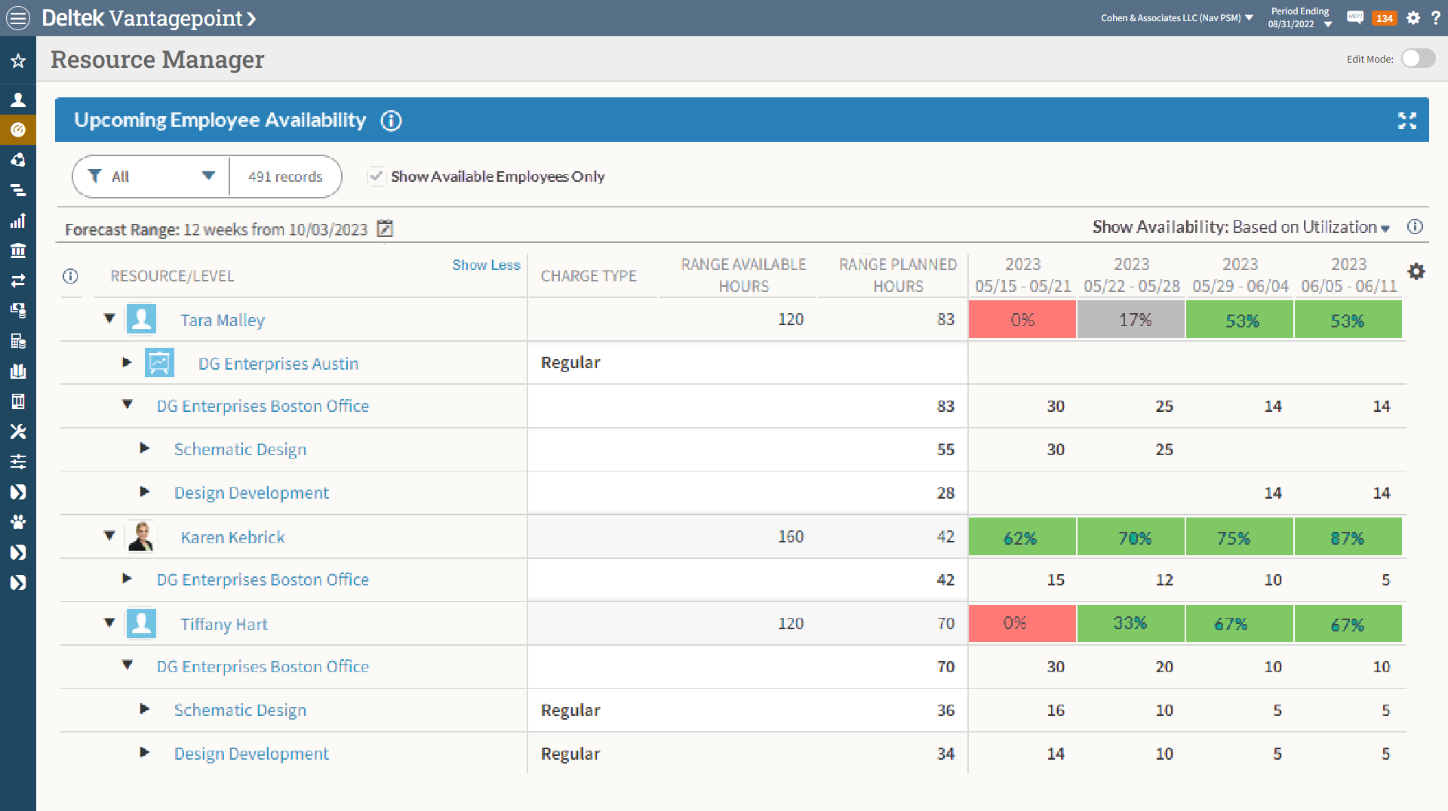
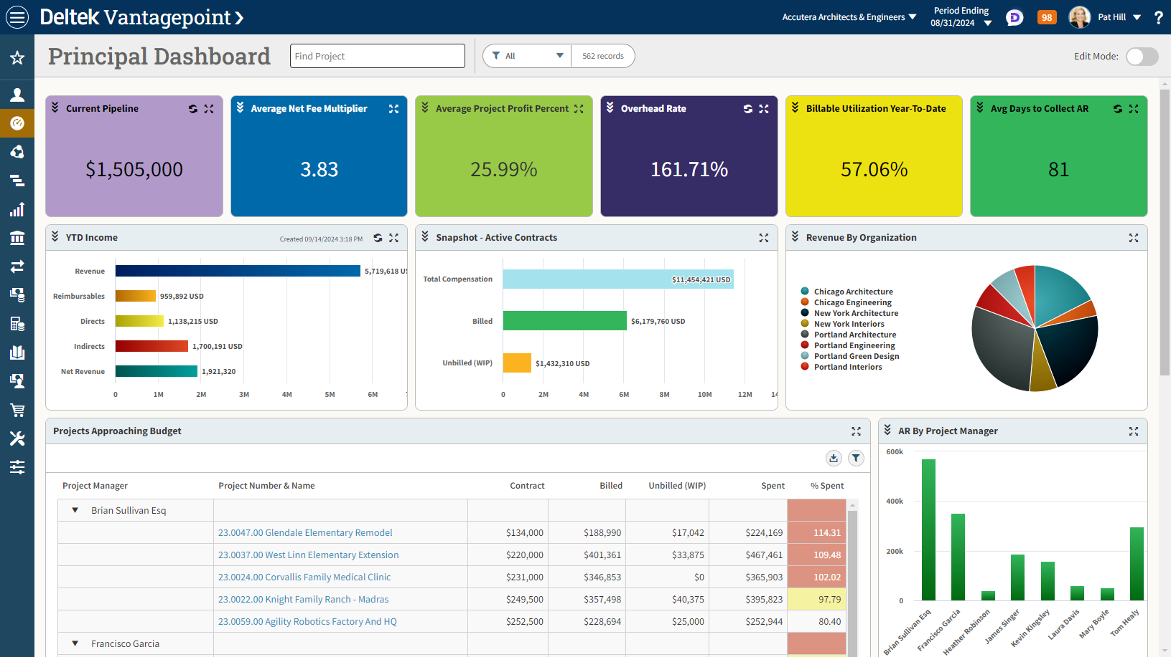
Progress, Progress, Progress
2.0
3.5
4.5
5.5
6.5
7.1
2017
2019
2020
2020
2021
2021
2022
2022
2023
2023
2024
2042
2024
1.0
3.0
4.0
5.0
6.0
7.0
7.2
Notes:
First, a quick update on the progress we have made since renaming the Vision product to Vantagepoint and starting on this journey to the next generation product. As of January 2025, we have done thirteen releases of Vantage Point, dating back to around 2017. And in that same time, many of our Vision using companies, have made progress as well.

Slide 3
Progress, Progress, Progress
2.0
3.5
4.5
5.5
6.5
7.1
1,800+ total companies using Vantagepoint live today
200,000+ users interacting with Vantagepoint daily
Companies of all sizes and types have upgraded – our largest enterprise companies (8,000 employees and greater) and our smallest companies (25 employees)
Approx 50% of current Vantagepoint customers upgraded from Vision
Thousands of customers participated in upgrade assistance program
Expecting significant surge of customers upgrading in 2025
2017
2019
2020
2020
2021
2021
2022
2022
2023
2023
2024
2042
2024
1.0
3.0
4.0
5.0
6.0
7.0
7.2
Notes:
Today we have just over 1,800 customers live on the Vantagepoint, 50% of which have upgraded from Vision. In addition, we have plenty of activity, some of that I'm sure from you, from other customers who are planning and or exploring their upgrade. We have tons of resources to help customers through their upgrades, including the ability to preview the product prior to upgrading, participate in our customer assistance program, and consume the massive amount of content from our Vantage Point readiness portal. As a result of all of this, we're expecting a significant surge of upgrade activity in the next 12-18 months. With all of that, you may be asking yourself the very reasonable question, why should my organization upgrade to Vantage Point?

Slide 4





Compelling Vision-Using Organizations to Upgrade
User Experience & Interface
Dashboards & Analytics
Fresh modern interface
Built with usability in mind
Reimagined features and improved user flows
More powerful and flexible user-defined componentry
Constantly evolving and improving based on user feedback
Browser and device agnostic – available on PCs, Macs, tablets
Modernized and expanded API
Project Command Center
Driving informed decision making – right data, right time
Rich graphical representation of organizational performance data
Provide key performance metrics
Create charts, graphs, lists and more to display data
Call attention to key areas
Included with core product
Innovation and Automation
Simplifying and streamlining the PM experience
Doubling down on project management functionality
Reimagining the resource planning toolset
Track the entire project lifecycle in one place
More intuitive and visual interface for PMs
V
Purposeful innovation to increase value and productivity
ICR
Dela AI capabilities
Fintech and automation
API modernization
Streamlining & Reimagination
Considering years of customer requests and feedback
Adding efficiency to key processes
Reimagining features and functionality
Vision’s Foundation
Vantagepoint is an upgrade from Vision – industry proven
Same underlying business logic
Notes:
There are many compelling reasons to upgrade to Vantage Point. However, there are six key items for you to contemplate that represent the power and opportunity VantagePoint can bring your company. This is power and capabilities that you will not get in your vision system today.

Slide 5
Compelling Vision-Using Organizations to Upgrade
User Experience & Interface
Dashboards & Analytics
Fresh modern interface
Built with usability in mind
Reimagined features and improved user flows
More powerful and flexible user-defined componentry
Constantly evolving and improving based on user feedback
Browser and device agnostic – available on PCs, Macs, tablets
Modernized and expanded API
Project Command Center
Driving informed decision making – right data, right time
Rich graphical representation of organizational performance data
Provide key performance metrics
Create charts, graphs, lists and more to display data
Call attention to key areas
Included with core product
Innovation and Automation
Simplifying and streamlining the PM experience
Doubling down on project management functionality
Reimagining the resource planning toolset
Track the entire project lifecycle in one place
More intuitive and visual interface for PMs
V
Purposeful innovation to increase value and productivity
ICR
Dela AI capabilities
Fintech and automation
API modernization
Streamlining & Reimagination
Considering years of customer requests and feedback
Adding efficiency to key processes
Reimagining features and functionality
Vision’s Foundation
Vantagepoint is an upgrade from Vision – industry proven
Same underlying business logic
Notes:
First and foremost, moving to VantagePoint is a vision upgrade. While it is a large upgrade, relatively speaking, it still is an upgrade from Vision 7.6, much like upgrading from Vision 7.5 to Vision 7.6. Why is this so important? It's important because VantagePoint is not a new product. It's not a re-implementation. VantagePoint is Vision renamed and reimagined, but it retains much of the underlying business logic, accounting engine, and core concepts. Upgrading is not starting over and learning a whole new product. Much of what you and your organizations already know about Vision carries forward to VantagePoint. Again, it's not starting over or re-implementing, making it a very manageable transition.

Slide 6
Compelling Vision-Using Organizations to Upgrade
User Experience & Interface
Dashboards & Analytics
Fresh modern interface
Built with usability in mind
Reimagined features and improved user flows
More powerful and flexible user-defined componentry
Constantly evolving and improving based on user feedback
Browser and device agnostic – available on PCs, Macs, tablets
Modernized and expanded API
Project Command Center
Driving informed decision making – right data, right time
Rich graphical representation of organizational performance data
Provide key performance metrics
Create charts, graphs, lists and more to display data
Call attention to key areas
Included with core product
Innovation and Automation
Simplifying and streamlining the PM experience
Doubling down on project management functionality
Reimagining the resource planning toolset
Track the entire project lifecycle in one place
More intuitive and visual interface for PMs
V
Purposeful innovation to increase value and productivity
ICR
Dela AI capabilities
Fintech and automation
API modernization
Streamlining & Reimagination
Considering years of customer requests and feedback
Adding efficiency to key processes
Reimagining features and functionality
Vision’s Foundation
Vantagepoint is an upgrade from Vision – industry proven
Same underlying business logic
Notes:
Now, while it is an upgrade from Vision, we have done a ton of streamlining and re-imagination. We have taken into consideration the feedback we've gotten from customers like you over the past 20 years and have taken the vantage point upgrade as an opportunity to enhance and expand capabilities and streamline key processes so that your organization can realize new efficiencies. There are many items that fall into this category, but some of the key re-imaginations include the convergence of the projects and opportunities info centers into the projects hub, combining clients and vendors into a single hub, recreating a proposal component, and significant improvements to the invoice review process and resource planning feature, just to name several. These re-imaginations will definitely pay dividends for your organizations.

Slide 7
Compelling Vision-Using Organizations to Upgrade
User Experience & Interface
Dashboards & Analytics
Fresh modern interface
Built with usability in mind
Reimagined features and improved user flows
More powerful and flexible user-defined componentry
Constantly evolving and improving based on user feedback
Browser and device agnostic – available on PCs, Macs, tablets
Modernized and expanded API
Project Command Center
Driving informed decision making – right data, right time
Rich graphical representation of organizational performance data
Provide key performance metrics
Create charts, graphs, lists and more to display data
Call attention to key areas
Included with core product
Innovation and Automation
Simplifying and streamlining the PM experience
Doubling down on project management functionality
Reimagining the resource planning toolset
Track the entire project lifecycle in one place
More intuitive and visual interface for PMs
V
Purposeful innovation to increase value and productivity
ICR
Dela AI capabilities
Fintech and automation
API modernization
Streamlining & Reimagination
Considering years of customer requests and feedback
Adding efficiency to key processes
Reimagining features and functionality
Vision’s Foundation
Vantagepoint is an upgrade from Vision – industry proven
Same underlying business logic
Notes:
Another thing that we have been squarely focused on with VantagePoint is Deltech's philosophy around innovation and that we are focused on what we call purposeful innovation. That is innovation that provides value through improved productivity and automation, not innovation just for the sake of innovation. VantagePoint has been able to take advantage of some key innovations around intelligent character recognition, artificial intelligence and machine learning, automation around FinTech, and modernization of our API tech stack and expanded API coverage. These innovations are just another way Vantage Point can provide expanded value for you and your businesses.

Slide 8
Compelling Vision-Using Organizations to Upgrade
User Experience & Interface
Dashboards & Analytics
Fresh modern interface
Built with usability in mind
Reimagined features and improved user flows
More powerful and flexible user-defined componentry
Constantly evolving and improving based on user feedback
Browser and device agnostic – available on PCs, Macs, tablets
Modernized and expanded API
Project Command Center
Driving informed decision making – right data, right time
Rich graphical representation of organizational performance data
Provide key performance metrics
Create charts, graphs, lists and more to display data
Call attention to key areas
Included with core product
Innovation and Automation
Simplifying and streamlining the PM experience
Doubling down on project management functionality
Reimagining the resource planning toolset
Track the entire project lifecycle in one place
More intuitive and visual interface for PMs
V
Purposeful innovation to increase value and productivity
ICR
Dela AI capabilities
Fintech and automation
API modernization
Streamlining & Reimagination
Considering years of customer requests and feedback
Adding efficiency to key processes
Reimagining features and functionality
Vision’s Foundation
Vantagepoint is an upgrade from Vision – industry proven
Same underlying business logic
Notes:
Now, while Vision has always been focused on project management, Vantage Point represents a significant amplification on project manager related functionality, and part of these improvements is our Project Command Center approach. The Project Command Center approach is the idea of getting everything in one place for project managers so they can pursue, plan, monitor, execute, and measure their projects all from a single location with tools that foster and align with project management best practices. We fully understand that your success is very closely dependent on the capabilities of your project managers. Therefore, we want to make sure we are doing everything we can through Vantage Point to empower and enable project managers and make their jobs easier so that they can focus on delighting your clients and delivering profitable projects. With VantagePoint, your project managers will have the best project management tools at their fingertips.

Slide 9
Compelling Vision-Using Organizations to Upgrade
User Experience & Interface
Dashboards & Analytics
Fresh modern interface
Built with usability in mind
Reimagined features and improved user flows
More powerful and flexible user-defined componentry
Constantly evolving and improving based on user feedback
Browser and device agnostic – available on PCs, Macs, tablets
Modernized and expanded API
Project Command Center
Driving informed decision making – right data, right time
Rich graphical representation of organizational performance data
Provide key performance metrics
Create charts, graphs, lists and more to display data
Call attention to key areas
Included with core product
Innovation and Automation
Simplifying and streamlining the PM experience
Doubling down on project management functionality
Reimagining the resource planning toolset
Track the entire project lifecycle in one place
More intuitive and visual interface for PMs
V
Purposeful innovation to increase value and productivity
ICR
Dela AI capabilities
Fintech and automation
API modernization
Streamlining & Reimagination
Considering years of customer requests and feedback
Adding efficiency to key processes
Reimagining features and functionality
Vision’s Foundation
Vantagepoint is an upgrade from Vision – industry proven
Same underlying business logic
Notes:
Similar to the Project Command Center concept, we've been hyper-focused on driving informed decision-making within your organizations. To do this, we need to make sure that everyone in your company has the right data at the right time. And as a result, we have completely reimagined the dashboarding functionality in VantagePoint. Now, Vision has always had a dashboard. However, VantagePoint takes this to a whole new level and focuses primarily on visualizing key data and metrics from the system. With the VantagePoint dashboards, you can create charts, graphs, and tables that present just the information relevant to your organization and or specific roles within your organization. You can call attention to key areas or conditions through rich graphical representations of the data to prompt action or lead your people to more detailed information. This dashboarding functionality is included with the core product, and it will definitely help you keep better track of your business and your projects and help drive more informed decision making.

Slide 10
Compelling Vision-Using Organizations to Upgrade
User Experience & Interface
Dashboards & Analytics
Fresh modern interface
Built with usability in mind
Reimagined features and improved user flows
More powerful and flexible user-defined componentry
Constantly evolving and improving based on user feedback
Browser and device agnostic – available on PCs, Macs, tablets
Modernized and expanded API
Project Command Center
Driving informed decision making – right data, right time
Rich graphical representation of organizational performance data
Provide key performance metrics
Create charts, graphs, lists and more to display data
Call attention to key areas
Included with core product
Innovation and Automation
Simplifying and streamlining the PM experience
Doubling down on project management functionality
Reimagining the resource planning toolset
Track the entire project lifecycle in one place
More intuitive and visual interface for PMs
V
Purposeful innovation to increase value and productivity
ICR
Dela AI capabilities
Fintech and automation
API modernization
Streamlining & Reimagination
Considering years of customer requests and feedback
Adding efficiency to key processes
Reimagining features and functionality
Vision’s Foundation
Vantagepoint is an upgrade from Vision – industry proven
Same underlying business logic
Notes:
And finally, and there's a reason this is the last of the six items, there is user experience. From day one with Vantage Point, we have set out to create a fresh, modern, accessible interface that delights and invites your users. We know that all the functionality in the world is not going to be valuable if it's not provided through an interface that is intuitive, visually appealing, and highly available. The Vantage Point interface is browser and device agnostic, meaning it can be accessed from just about anywhere, and in addition, the intuitiveness of the interface will invite your users into all of the power that sits behind that interface.

Slide 11
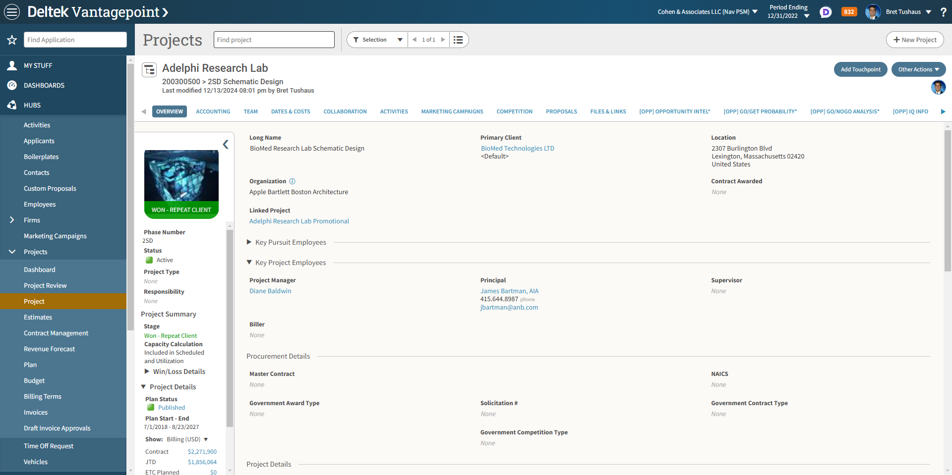
Vantagepoint
Value Drivers
Fresh, modern interface – usability focus drives user adoption
Visibility into your business – accessibility of information and pervasiveness of performance indicators drives informed decision making
Project focused business development - all the tools and touch points to cultivate relationships and opportunities
Project command center – project managers can track entire project lifecycle in a single location
Notes:
Now as we think about those six key tenets, how does that translate into value for your organization? And of course there are several ways and it's important to think about this in the context of what you get from Vantage Point that you don't currently get from Vision. Yes, Vision as the foundation has all kinds of value drivers about which your organization is most likely already aware, but the value drivers I am covering here are all net new when you upgrade to Vantage Point, which is why these are so compelling to consider as you contemplate your upgrade. First, as I just mentioned, that fresh modern interface is key to driving user adoption, and the more adoption your organization realizes, the more value you'll get out of Vantage Point.

Slide 12
Vantagepoint
Value Drivers
Fresh, modern interface – usability focus drives user adoption
Visibility into your business – accessibility of information and pervasiveness of performance indicators drives informed decision making
Project focused business development - all the tools and touch points to cultivate relationships and opportunities
Project command center – project managers can track entire project lifecycle in a single location
Notes:
Also, as already mentioned, when it comes to the dashboarding functionality, visibility into your business is key. Again, we want to drive informed decision making. The ability to identify a potential issue before it becomes a major problem is extremely powerful so that you can course correct before it's too late. That's what the dashboarding functionality is all about, and I'm confident your firms will be smarter about your business with Vantage Point in place.

Slide 13
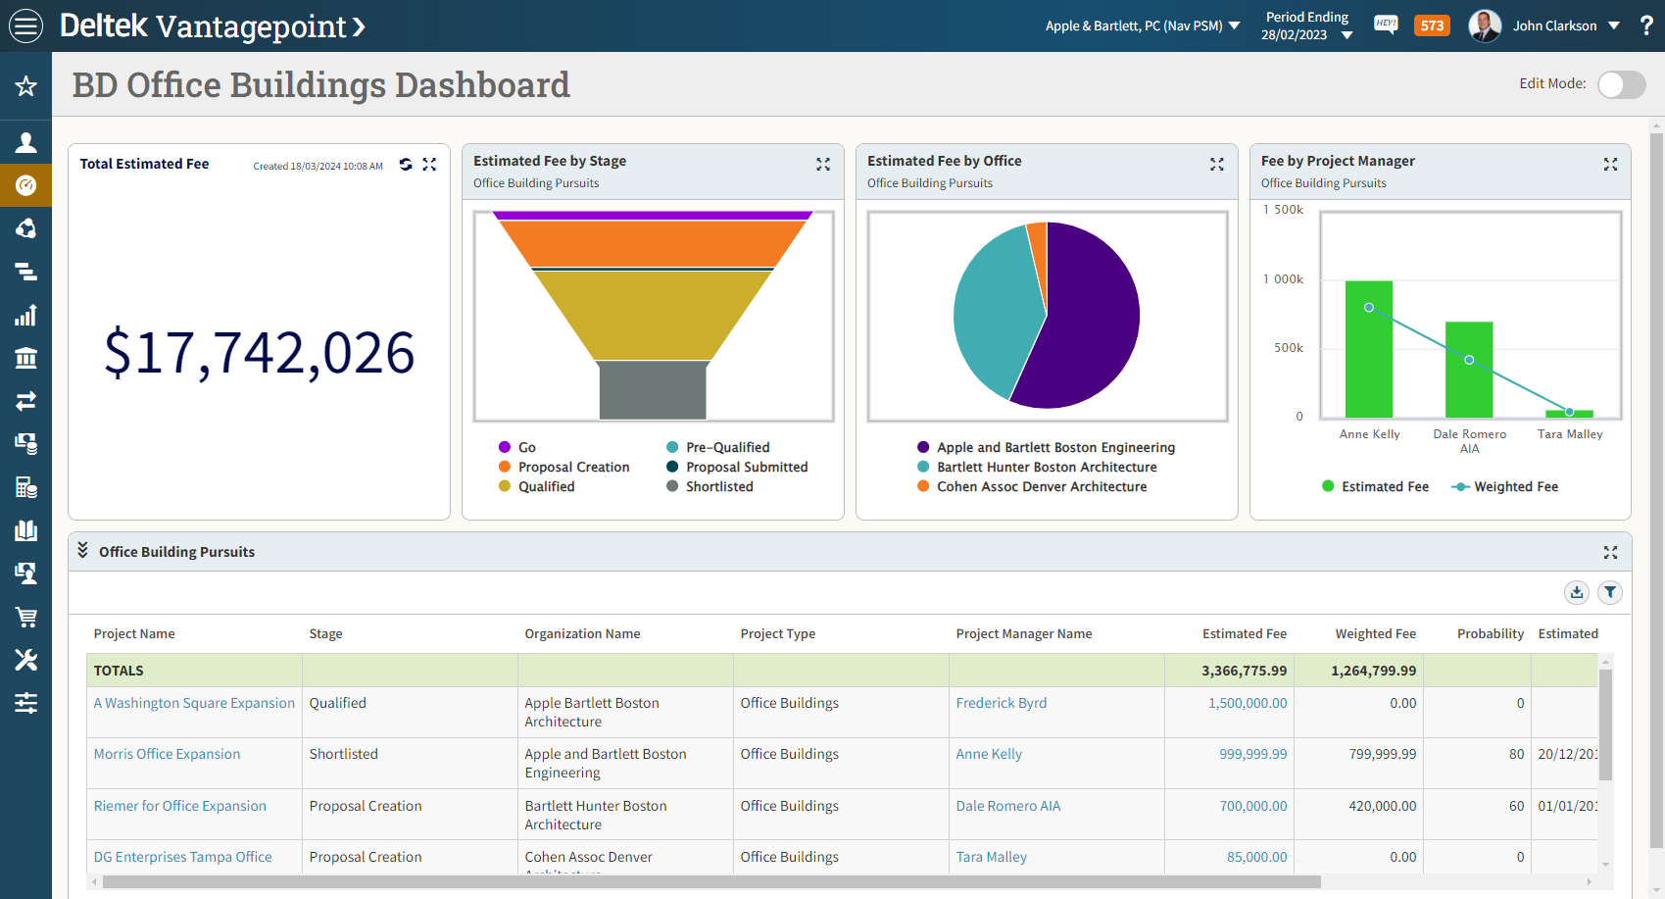
Vantagepoint
Value Drivers
Fresh, modern interface – usability focus drives user adoption
Visibility into your business – accessibility of information and pervasiveness of performance indicators drives informed decision making
Project focused business development - all the tools and touch points to cultivate relationships and opportunities
Project command center – project managers can track entire project lifecycle in a single location
Notes:
Another area we've also improved in Vantage Point is around business development and CRM. With Vantage Point's unique project-focused CRM, your companies can ensure that you're optimizing your pursuit of new business. Through all the tools around managing leads and opportunities, touch points for cultivating relationships, and proposals for representing your company's capabilities as best as possible, you can ensure you keep your win rate at peak levels.

Slide 14
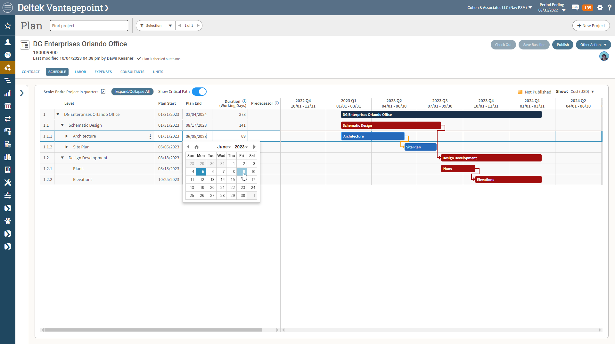
Vantagepoint
Value Drivers
Fresh, modern interface – usability focus drives user adoption
Visibility into your business – accessibility of information and pervasiveness of performance indicators drives informed decision making
Project focused business development - all the tools and touch points to cultivate relationships and opportunities
Project command center – project managers can track entire project lifecycle in a single location
Notes:
Now I did already mention this but it's definitely worth mentioning again and that is the Project Command Center concept. Again, Vantage Point equips project managers with a one-stop shop for all things project management. That is the ability
to manage the entire lifecycle of project from a single location.

Slide 15
Vantagepoint
Value Drivers
Built around resource planning – have the right people on the right projects to ensure project success and profitability
Accessible and intuitive time and expense – supporting efficiency and simplicity in heaviest used part of the system
Streamlined back office experience – easy navigation, single points of entry and extensive auditability to support back office accuracy and speed
Elegant billing processes – reduced
time from draft to final invoice and extensive visibility into billing
information and statuses
Notes:
A key part of the Project Command Center is the resource planning capabilities. This is all about having the right people on the right projects to ensure success and profitability. And a key part of that is also making sure you are managing those resources in an optimal way across the entire business. ManagePoint Resource Management functionality has been significantly redesigned to make it more powerful, easier to use, and more accessible to your project managers. And of course, all of that is related back to the Project Command Center concept. Again, successful project managers lead to successful, profitable businesses.

Slide 16
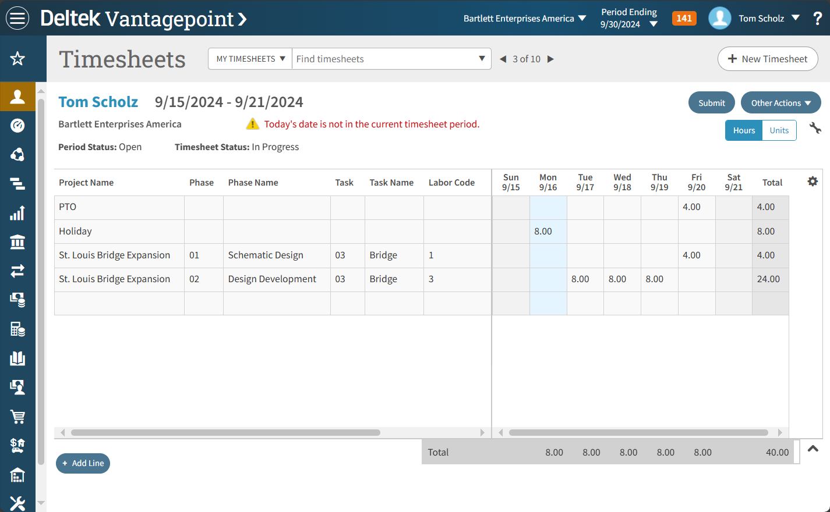
Vantagepoint
Value Drivers
Built around resource planning – have the right people on the right projects to ensure project success and profitability
Accessible and intuitive time and expense – supporting efficiency and simplicity in heaviest used part of the system
Streamlined back office experience – easy navigation, single points of entry and extensive auditability to support back office accuracy and speed
Elegant billing processes – reduced
time from draft to final invoice and extensive visibility into billing
information and statuses
Notes:
Now, so far we have talked a lot about project managers, business developers, and other specific roles in the business. But what about the everyday user of a product like VantagePoint? We understand the importance of timely, accurate time sheets and expense reports to keep the business moving along. As a result, we have reimagined several aspects of time and expense entry to make it more intuitive for that everyday user. This results in timesheets and expense reports getting submitted on time and submitted accurately and equally important, less time spent on chasing down to get this information entered and submitted and chasing down corrections. All of this pays dividends for the organization as a whole.

Slide 17
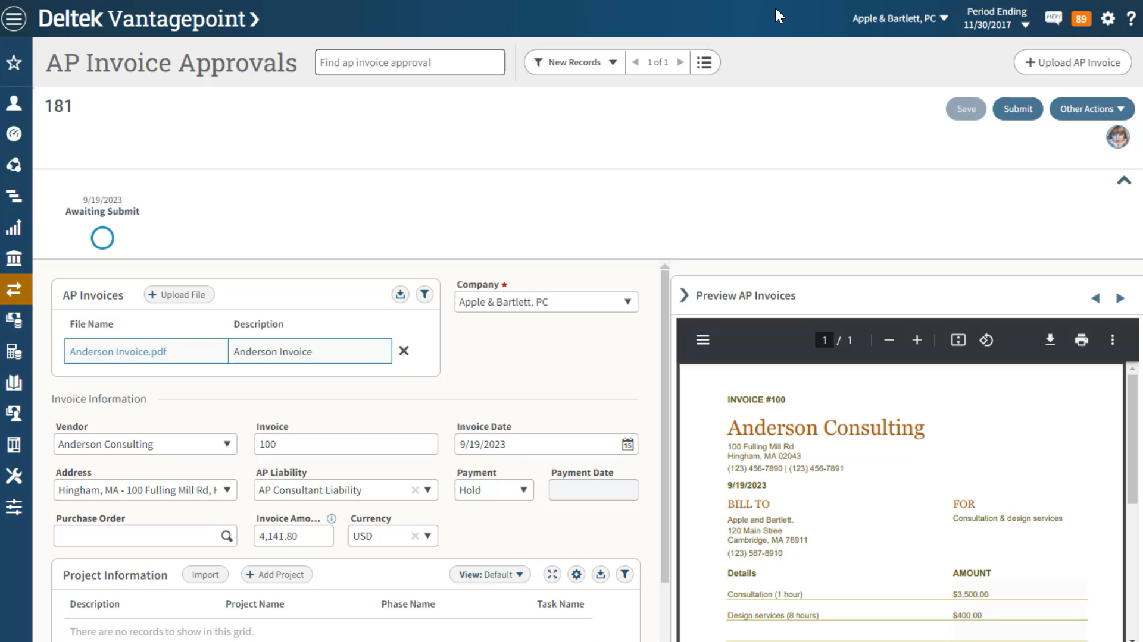
Vantagepoint
Value Drivers
Built around resource planning – have the right people on the right projects to ensure project success and profitability
Accessible and intuitive time and expense – supporting efficiency and simplicity in heaviest used part of the system
Streamlined back office experience – easy navigation, single points of entry and extensive auditability to support back office accuracy and speed
Elegant billing processes – reduced
time from draft to final invoice and extensive visibility into billing
information and statuses
Notes:
And finally, a couple of key value drivers that relate to the finance and accounting side of the business. With Vantage Point, we are constantly looking for ways to ease navigation, reduce the number of clicks, and consolidate entry points for your back office users. After all, getting invoices out the door and cash in the door is obviously critical to your business. So, any efficiencies we can add to that part of the system is definitely good for business as well, and Vantage Point has many.

Slide 18
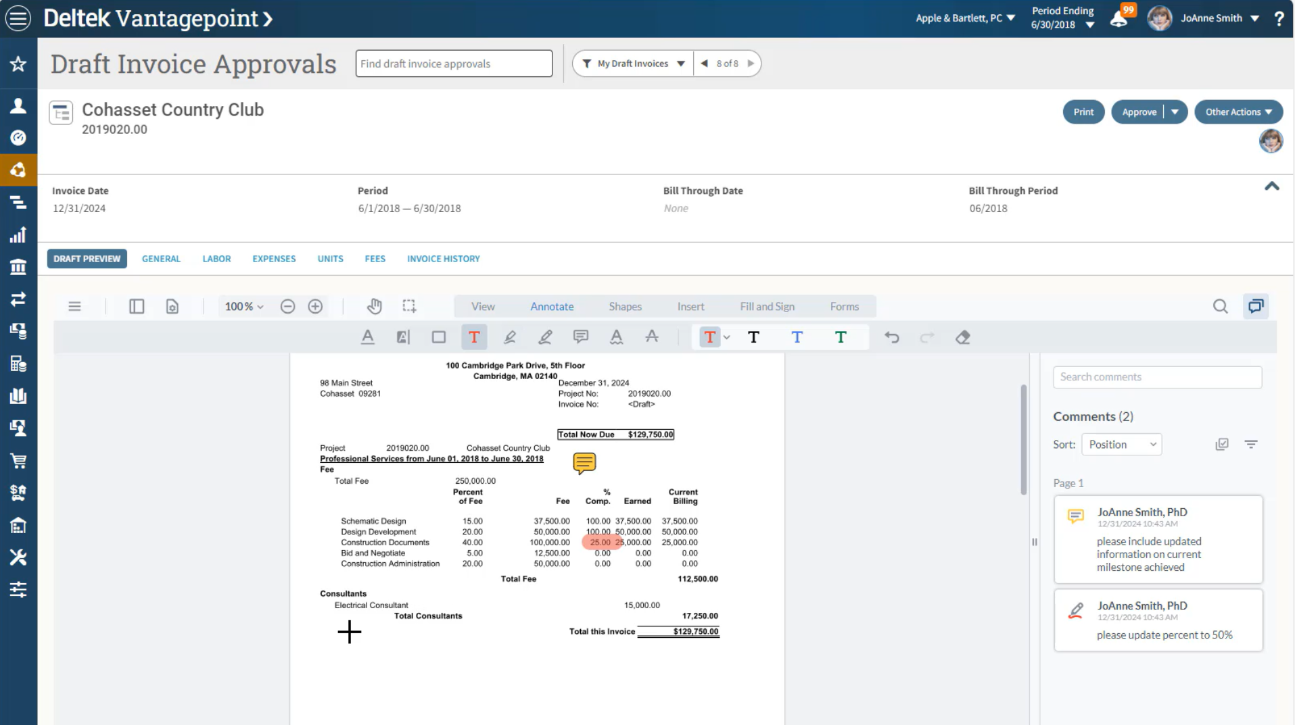
Vantagepoint
Value Drivers
Built around resource planning – have the right people on the right projects to ensure project success and profitability
Accessible and intuitive time and expense – supporting efficiency and simplicity in heaviest used part of the system
Streamlined back office experience – easy navigation, single points of entry and extensive auditability to support back office accuracy and speed
Elegant billing processes – reduced
time from draft to final invoice and extensive visibility into billing
information and statuses
Notes:
And when it comes to getting invoices out the door, we have made significant improvements in this area of the product around draft invoice review process, which provides new visibility and new interactions to get those invoices reviewed and accurate and out to your clients as efficiently as possible.
As you can see, there are a lot of foundational value drivers with Vantage Point. And again, this is all improvement over what you have envisioned today.

Slide 19
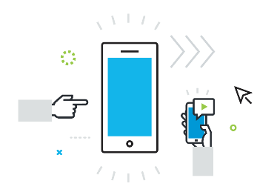
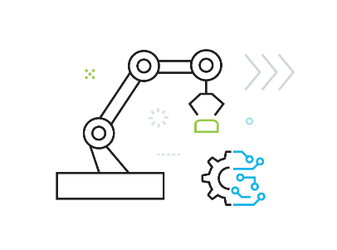
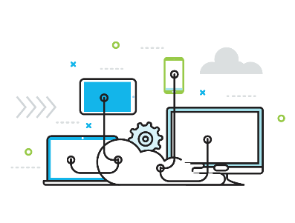
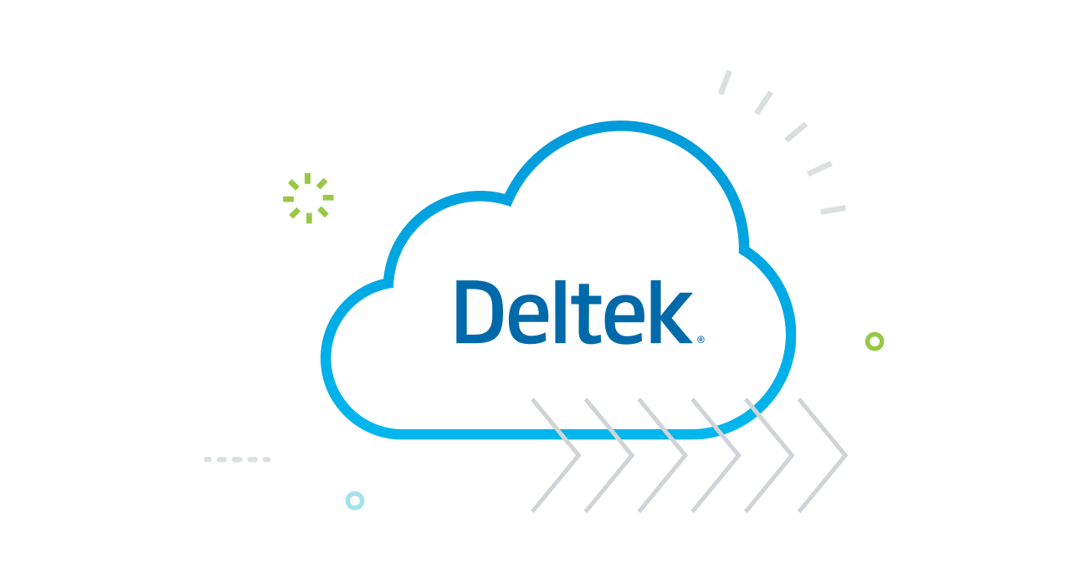
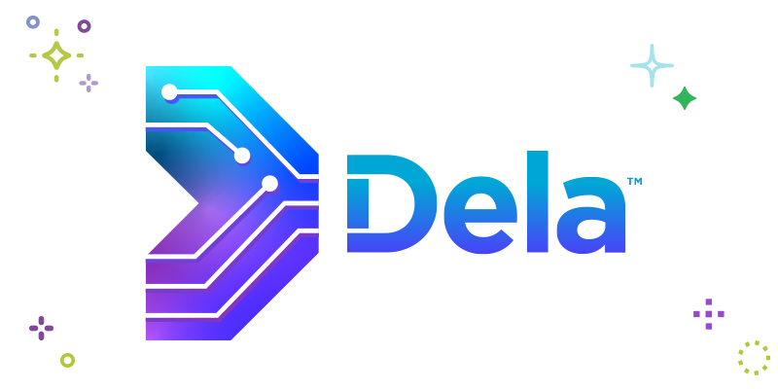
Purposeful Innovation That Powers Projects
User Experience
Artificial Intelligence
Automation
API Modernization
Cloud First
User experience goes beyond aesthetics—it’s about creating software that aligns with how our users operate and to be as user-friendly and intuitive as their everyday applications.
Integrating generative AI and machine learning into our industry-specific solutions enabling users to measure, predict, prescribe and automate various business processes.
Process optimization and automation to streamline workflows and enhance efficiency. Helping reduce costs and empower teams to work smarter.
A modern API tech stack and broad API coverage is important to support companies in the common need to connect the various systems they use to run their business.
Cloud first approach helps businesses scale up or down to meet their needs, freeing resources for project delivery and in turn provides cost efficiencies and systems security.
Notes:
But with those value drivers also comes the innovation I mentioned earlier as well. That is purposeful innovation, key new techniques and technologies to further improve your experience with VantagePoint and introduce new capabilities and new efficiencies.
At the company level at Dell Tech, our purposeful innovation is currently focused on the five items you see here. Those are user experience, artificial intelligence and machine learning, automation, modernizing our API coverage and finally a cloud first approach to our solutions. Many of these innovation areas of focus have manifested themselves as new features and functionality within VantagePoint, all of which you'll be able to leverage when you upgrade.

Slide 20
Purposeful Innovation That Powers Projects
User Experience
Artificial Intelligence
Automation
API Modernization
Cloud First
User experience goes beyond aesthetics—it’s about creating software that aligns with how our users operate and to be as user-friendly and intuitive as their everyday applications.
Integrating generative AI and machine learning into our industry-specific solutions enabling users to measure, predict, prescribe and automate various business processes.
Process optimization and automation to streamline workflows and enhance efficiency. Helping reduce costs and empower teams to work smarter.
A modern API tech stack and broad API coverage is important to support companies in the common need to connect the various systems they use to run their business.
Cloud first approach helps businesses scale up or down to meet their needs, freeing resources for project delivery and in turn provides cost efficiencies and systems security.
Notes:
First and something about which we already talked at length is the fresh modern interface. This comes through loud and clear in VantagePoint as we have innovated around the interface to make it as accessible and intuitive as possible in VantagePoint.

Slide 21


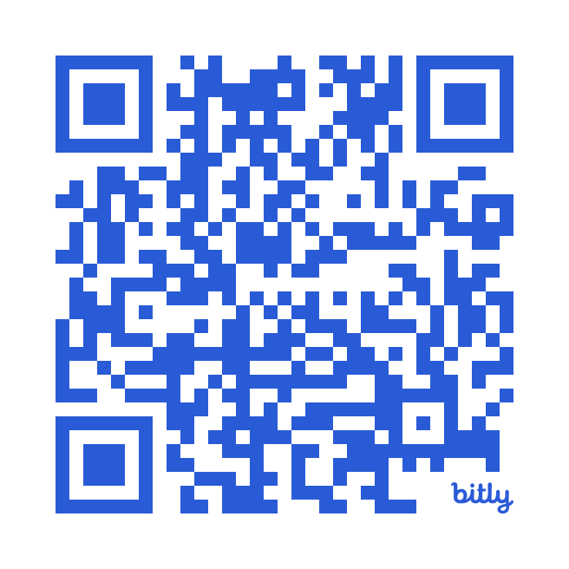
Intuitive Design for Modern Workforce
Hyper focus on delivering a consistent, intuitive user experience across our entire portfolio, designed to streamline workflows, reduce training costs and simplify implementation.
Simplicity
Context
Versatility
Unification
https://www.deltek.com/en/innovation/ux/harmony
Learn More About Harmony…
Notes:
In fact, Deltek has recently doubled down even further on our focus on user experience and introduced Deltek Harmony which is our overarching user experienced and user interface initiative focus on simplicity, unification, contextual awareness and versatility. Again, aimed at foster that intuitive user experience that will help streamline your users’ workflows, reduce the amount of training users need and simplify your implementations. Deltek is applying the Harmony framework across our entire product portfolio and some elements have already started to surface in Vantagepoint and there will be much more progress to come.

Slide 22
Purposeful Innovation That Powers Projects
User Experience
Artificial Intelligence
Automation
API Modernization
Cloud First
User experience goes beyond aesthetics—it’s about creating software that aligns with how our users operate and to be as user-friendly and intuitive as their everyday applications.
Integrating generative AI and machine learning into our industry-specific solutions enabling users to measure, predict, prescribe and automate various business processes.
Process optimization and automation to streamline workflows and enhance efficiency. Helping reduce costs and empower teams to work smarter.
A modern API tech stack and broad API coverage is important to support companies in the common need to connect the various systems they use to run their business.
Cloud first approach helps businesses scale up or down to meet their needs, freeing resources for project delivery and in turn provides cost efficiencies and systems security.
Notes:
Artificial intelligence is also and area where we have made a ton of progress across Deltek and especially within Vantagepoint.

Slide 23
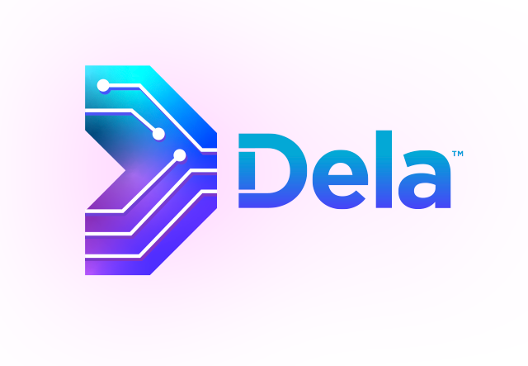


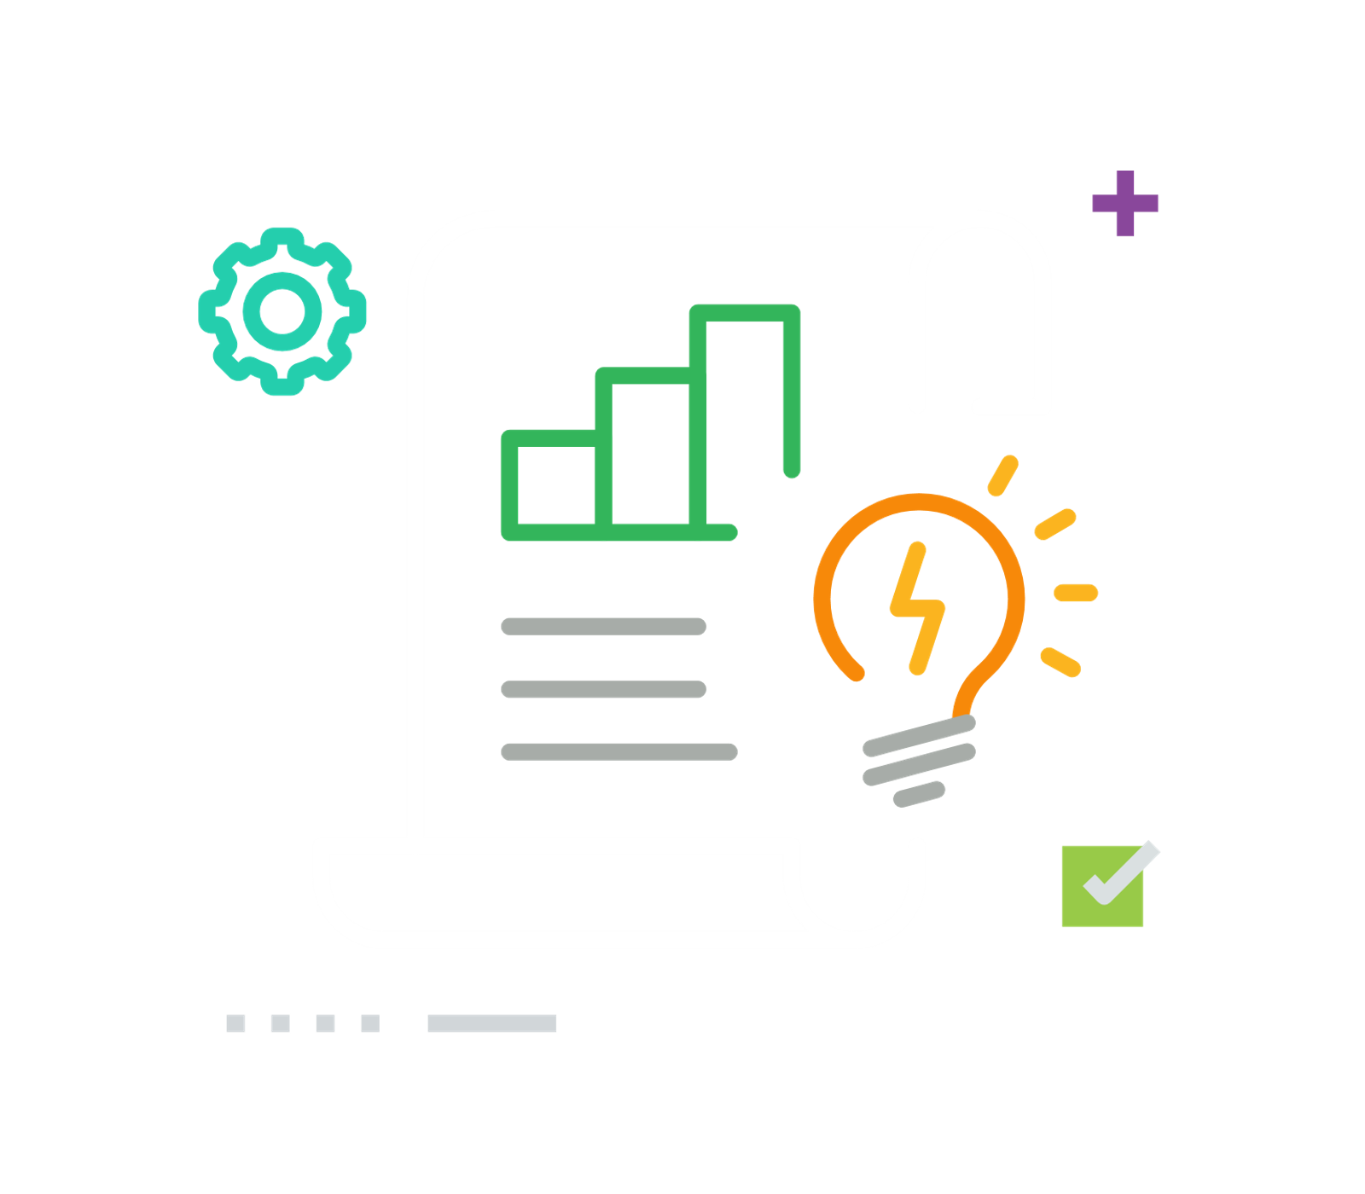

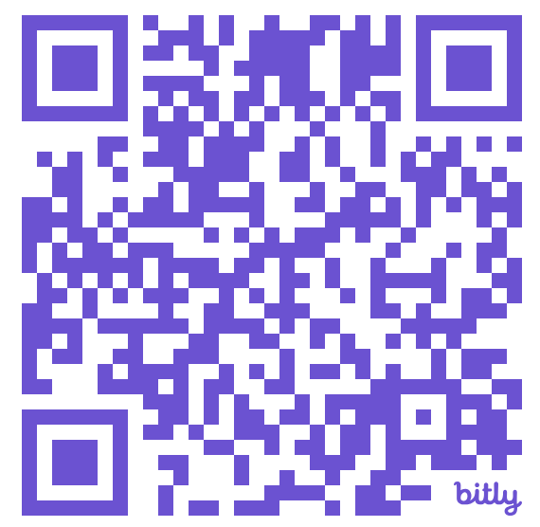
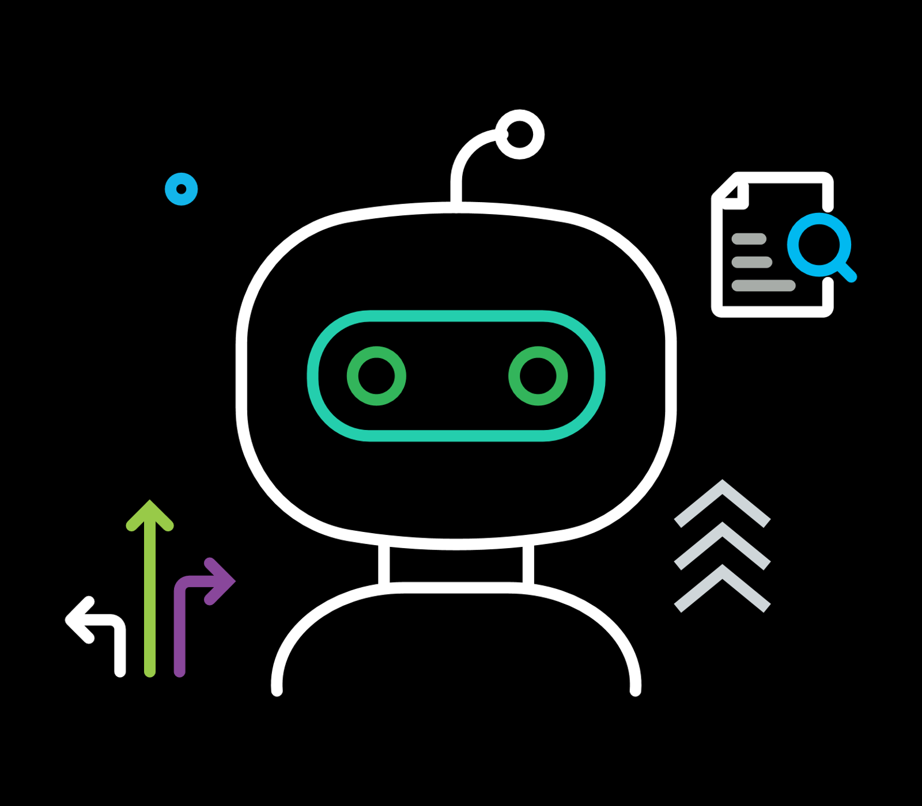

Deltek Dela™: AI-Powered Business Companion
Deltek Dela, our AI-powered intelligent business companion, is revolutionizing project delivery.
Dela leverages purposeful innovation to enhance productivity, accuracy and value across the project lifecycle and enables project-based businesses to be more productive and efficient with our industry-specific solutions.
Generate & Automate Smart Content
Predict Project & Organizational Success
Enable Intelligent Exploration
https://www.deltek.com/en/innovation/dela-ai
See What Dela is Doing Across Deltek Portfolio…
Notes:
And, similar to our overarching Harmony UX initiative, we introduced Deltek Dela in the past year as our AI-Powered Business Companion. Dela represents all of the AI and machine learning features and functionality we have been introducing across the product portfolio. Dela, today, is focused on three key areas – generating and automating smart content, predicting both project and organizational success and enabling intelligent exploration. Specifically in Vantagepoint we have introduced both Client and Project smart summary capabilities which leverages generative AI to create natural language executive summaries in real time on key records from the Vantagepoint system. And, one of our most exciting new features that has left Vantagepoint users raving is our Ask Dela digital assistant which gives you the ability to have a conversation, if you will, with Vantagepoint to inquire about key information, project metrics and insights…through a natural language interface without ever running a single report or even knowing where to find the type of info for which you are looking.
We are excited about where we are taking our AI capabilities next under the Dela umbrella and further empowering you and your organizations with this AI powered business companion.

Slide 24
Purposeful Innovation That Powers Projects
User Experience
Artificial Intelligence
Automation
API Modernization
Cloud First
User experience goes beyond aesthetics—it’s about creating software that aligns with how our users operate and to be as user-friendly and intuitive as their everyday applications.
Integrating generative AI and machine learning into our industry-specific solutions enabling users to measure, predict, prescribe and automate various business processes.
Process optimization and automation to streamline workflows and enhance efficiency. Helping reduce costs and empower teams to work smarter.
A modern API tech stack and broad API coverage is important to support companies in the common need to connect the various systems they use to run their business.
Cloud first approach helps businesses scale up or down to meet their needs, freeing resources for project delivery and in turn provides cost efficiencies and systems security.
Notes:
When it comes to automation, we know that today’s technology stack is more powerful than ever when it comes to automating tasks for you so that people within your organization can spend more time on value added tasks. Therefore, through things like expanding the workflow capability in Vantagepoint and creating more opportunities for the system to handle processes in the background, we continue to push and innovate in the context of automation.

Slide 25
Purposeful Innovation That Powers Projects
User Experience
Artificial Intelligence
Automation
API Modernization
Cloud First
User experience goes beyond aesthetics—it’s about creating software that aligns with how our users operate and to be as user-friendly and intuitive as their everyday applications.
Integrating generative AI and machine learning into our industry-specific solutions enabling users to measure, predict, prescribe and automate various business processes.
Process optimization and automation to streamline workflows and enhance efficiency. Helping reduce costs and empower teams to work smarter.
A modern API tech stack and broad API coverage is important to support companies in the common need to connect the various systems they use to run their business.
Cloud first approach helps businesses scale up or down to meet their needs, freeing resources for project delivery and in turn provides cost efficiencies and systems security.
Notes:
We also know that your businesses use other best of breed and point solutions to operate your business that are not Deltek products. Therefore, we understand the importance of providing a modern API tech stack within our products and broad functional coverage with our APIs so that you, if needed, can connect Vantagepoint to these other systems. Vantagepoint now has a modern RESTful based API platform and we are continually expanding the areas of the product covered by the API.

Slide 26
Purposeful Innovation That Powers Projects
User Experience
Artificial Intelligence
Automation
API Modernization
Cloud First
User experience goes beyond aesthetics—it’s about creating software that aligns with how our users operate and to be as user-friendly and intuitive as their everyday applications.
Integrating generative AI and machine learning into our industry-specific solutions enabling users to measure, predict, prescribe and automate various business processes.
Process optimization and automation to streamline workflows and enhance efficiency. Helping reduce costs and empower teams to work smarter.
A modern API tech stack and broad API coverage is important to support companies in the common need to connect the various systems they use to run their business.
Cloud first approach helps businesses scale up or down to meet their needs, freeing resources for project delivery and in turn provides cost efficiencies and systems security.
Notes:
And finally, we continue to build on what we started over 12 years ago when you, our customer based, demanded cloud-based solutions. Across the Deltek product portfolio, including Vantagepoint, we are taking a cloud first approach in how we design and architect the product so that it can thrive in the cloud and provide an accessible, secure and performant solution for your businesses. With more than 60% of our customers consuming our solutions via the Deltek cloud, this is a critical focus of ours and an area of innovation we will continue to both progress and optimize.

Slide 27
Compelling Vision-Using Organizations to Upgrade
Strong roadmap;
solid strategy
Vantagepoint will be unmatched
in the market
In totality, there is no better product,
purpose-built for your industry
We are committed to you, your businesses and your industry
All organizations will benefit from the value Vantagepoint brings
Vantagepoint is an evolution that will help future-proof your business
V
Notes:
Again, Vantage Point is filled with purposefully innovative components that will pay dividends for you and for your organizations. And that brings us to some key foundational facts around Vantage Point, all of which you should think about as you contemplate your upgrade division. In addition to the key tenants and value drivers I just shared, with Vantage Point you also get a strong roadmap based on a very solid strategy. You'll get a solution that holistically will be unmatched in the market and a solution for which there is no comparison in the industries Deltech serves. Deltech is committed to your industry and we have been for over 40 years. I have no doubt that all organizations will benefit from upgrading to Vantage Point and doing so will help power your digital transformation and future-proof your business.

Slide 28

What are Vision organizations saying?
“I LOVE the new EPSG, and greatly appreciate the opp/project merge concept from a business logic perspective.”
“As a former Project Accountant who trained many people on Vision, the new project hub and structure is more user friendly.”
“Really cool! I feel I get the power of Word with some of the best features at my finger tips. It seems very powerful and simple.”
“I love the timeline. This is something that I think PMs and the team will use a lot. “
“
”
“This is a really neat feature…it'll be great for our employees that do things once or twice a month but forget how to do things the other times.”
“I really like this new search dialog. It is much more user friendly and clear.”
Notes:
Of course, hearing this all from me would certainly be expected. What are organizations and users saying that are currently using VantagePoint? Currently, we have over 1,800 customers using VantagePoint, as I mentioned earlier, and user feedback on specific features has been extremely positive. Both the fresh, modern interface has been received very well, and specific functionality has been praised and celebrated. This represents that we are hitting our marks when it comes to the reimagination we set out to do when we embarked on the Vantage Point journey.

Slide 29
What are Vision organizations saying?
“I have not heard one person in 800 people say they wish we hadn’t changed systems…it’s not always 100% the way they want it, but what I hear from the staff is that it’s a lot better than what we had. From getting time entered to getting invoices out the door – those groups didn’t miss a beat. Our cash application and project setup teams had a similar experience.”
“Users are becoming very engaged in the product, more so than they ever were in Vision, including Project Managers….it's like going from the Flintstones to the Jetsons overnight!"
”
“
“The user interface really matched the feel of the functionality and made it very easy to use. We loved the idea of being able start tracking information as an opportunity and then being able to flip the stage and move on to delivery. This is really nice”
Notes:
And we're also having organizations commenting on their upgrade journey and our experience with Vantage Point. The quotes you see here represents real world experience from real world Vantage Point customers. They appreciate the interface, the functionality, and the overall capabilities the solution brings to their businesses. These quotes represent a small sampling of many happy Vantage Point organizations and demonstrate the dividends vision using organizations will realize when they upgrade. I especially like the Flinstones to Jetsons analogy…for those of us that still remember those classic cartoons.

Slide 30



Compelling Vision-Using Organizations to Upgrade
What’s Best for Your Business
Employee Retention
Competitive Pressure
Organizations running Vision are running on old technology – from 2008. For your business to progress you need to progress your technology. A part of your digital transformation.
Your people and your potential hires expect good technology. Good user experience and accessible solutions. Good tech can attract and retain good people.
Your competitors who have upgraded have access to better tech, better functionality. Improved efficiencies and capabilities. Do not let your competitors get ahead of you.
Notes:
And lastly, one other lens to look through as you contemplate why you should upgrade from vision to Vantage Point. These are three bonus value drivers, if you will, that all organizations should consider in today's day and age. First, while Vision is a solid, industry-proven solution, it is an older system based on older technology. It's important that organizations consider this in their broader digital transformation journey. To progress your business, you need to progress your technology, and a vantage point upgrade is a key part of that.
Second, we all know how critical attracting and retaining talent is in the current employment market. Technology can contribute and help with this. Your people expect good technology and a good powerful user experience with the tools they use. This is the nature of the workforce these days. Good technology like Vantage Point can attract and retain good people.
And third, you never want to let your competitors get ahead of you. Your competitors who have upgraded have access to better technology, better functionality and efficiencies. Think about your Vantage Point upgrade as another way to stay ahead of the competition.

Slide 31
Vantagepoint
Commitment
Strong roadmap; solid strategy
Vantagepoint will be unmatched in the market
In totality, there is not a better product out there, purpose-built for your industry
We are committed to you, your businesses and your industry
All organizations will benefit from the value Vantagepoint brings
Vantagepoint is an evolution that will help future-proof your business
Notes:
So with all of these key tenets, value drivers, testimonials and commentary on why your organization should upgrade to Vantage Point, I'll leave you with this final statement on our Vantage Point commitment. Again, we have a strong roadmap built on a solid strategy. Vantage Point is by far the best purpose-built solution for your industry and Dell Tech is and has always been committed to your industry. And I truly believe that you will see value and see benefits from upgrading to VantagePoint and will take you and your business successfully into the future.

Slide 32
Thank you!
vantagepoint@deltek.com
Notes:
Thank you so much for taking the time to watch this video and be sure and check out the other videos in this series that dive into more details about specific features and functionality across the product that only further reinforce the many compelling reasons to upgrade to VantagePoint.
And if you have any questions in regards to VantagePoint or your upgrade, please do not hesitate to contact us by the email address you see here vantagepoint at deltech.com. Thank you again and thank you for your ongoing commitment to Deltech and the Vision and VantagePoint solution.

